Slide 1

Colombian personality of the year
Pedro Claver Zuluaga

Slide 2
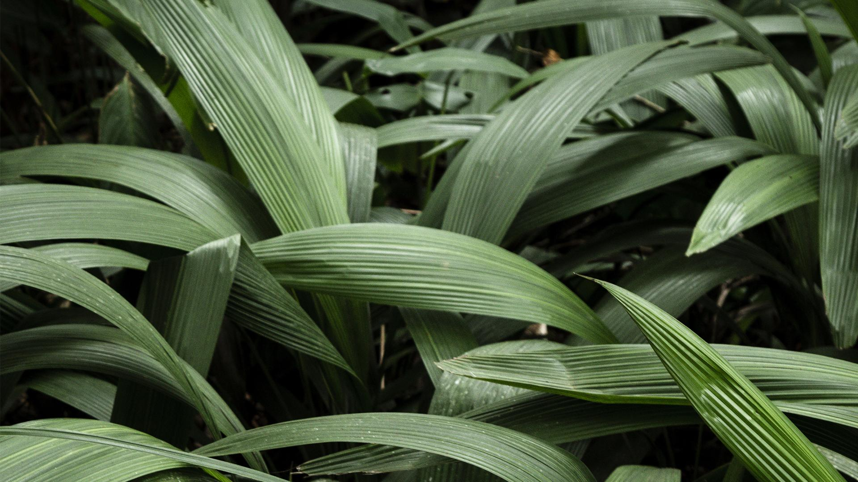
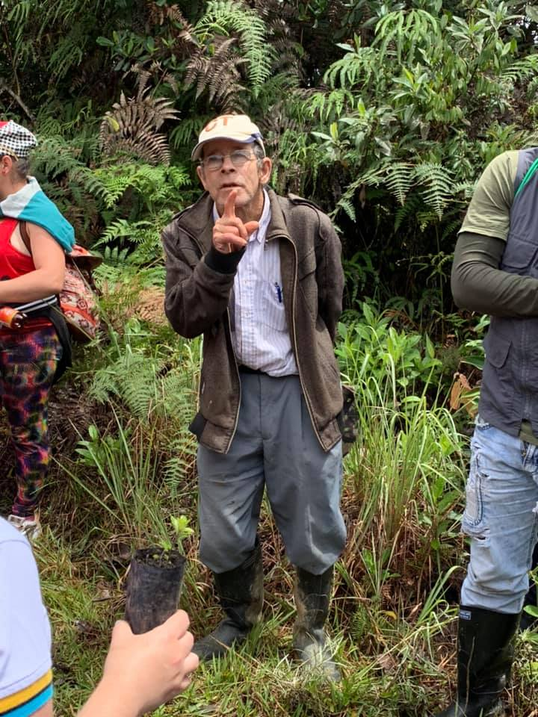
Introduction
Enter a subtitle here if you need it

Slide 3

Don Pedro’s labors
He takes care of the environment
Educates young people
Raising public awareness about nature
He protects the wildlife in his territory

